Slide 1
Options 2025
January 2025
Mr Faux / Mrs Henderson

Slide 2
This Session
What are Options?
How Careers and Options interlink
What Subjects STUDENTS have to Take
The English Baccalaureate
The Options Process

Slide 3
Timeline
Options
Year 9
2024-25
GCSE’s
Year 10-11
2025-2027
Post-16
Year 12-13
2027-2029
University / College / Job
2029-2032+
3 Years or Longer
Options Process
Application to Sixth Form
Application to University/College

Slide 4
What Are Options?

Slide 5
Options
Options is the process of deciding the qualifications you will take at the end of Year 11. These are GCSE or equivalent qualifications. Some equivalent qualifications are BTECs or Cambridge Nationals, they all have the same value.
They are what are known as Level 2 qualifications.
GCSEs are graded 1-9 with 9 the highest. BTECs are graded Pass, Merit, Distinction and Distinction*.
Some subjects will be compulsory.
The first chance for students to choose which subjects they want to study.
The first chance to specialise in areas that interest them.

Slide 6
1-9 Vs A*-E

Slide 7
Options Link With Careers

Slide 8
Fundamentally
GCSEs are a gateway to the next step in education and getting a job in the field that your child would like to get a job in. All students must be in education until the age of 18.
This is why, even at this point, thinking about the following step is important. Will you be doing A-Levels or a practical course. If you do not pick a subject at GCSE you may find the A-Level more challenging, especially the Sciences.
While this choice does not definitely lock off any career it will influence future direction.
Not getting 4s in English and Mathematics means compulsory retakes throughout Post 16.

Slide 9
Talking to your Child About Careers
Career
Money
Happiness
Interesting
Time
People
Status

Slide 10
Questions for Students to Ask Themselves
What does the job I want pay?
Where is the job I want located?
What grades do I need?
Do I want to go to University?
Who do I want to work for?
What does a normal day look like?
Do I want to work with computers all day?
Do I want to work outside?
Do I want to work from home?
Do I want to work in this country?
Could I see myself doing this for 50 years?
If you love your job, you will never work a day in your life.

Slide 11
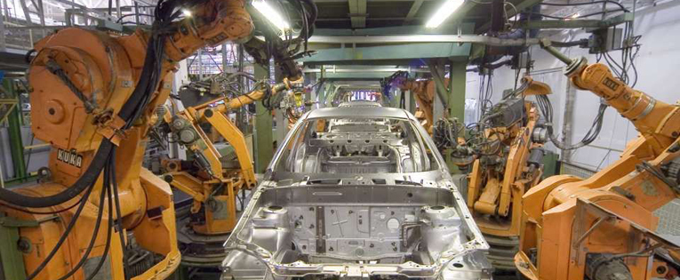
Job Market Changes
Globalisation
Mechanisation
Cheap Imports
Social Change
AI
You need to have skills that people need when you start to enter the job market.

Slide 13
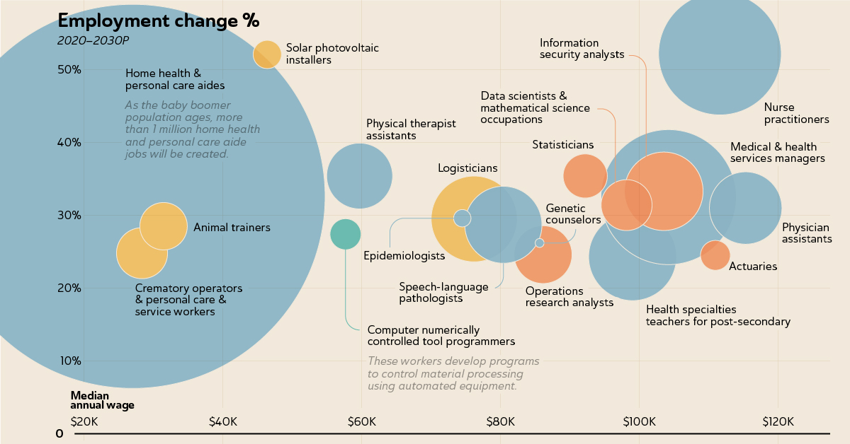
The World is Changing - Opportunities

Slide 14
Compulsory Subjects

Slide 15
Compulsory Subjects for All Students
English Language
English Literature
Mathematics
Combined Science
These are worth 5 GCSEs.
Students will also continue to have non examination PE and Personal Development which contains statutory Religious Education. There are no qualifications for these areas.

Slide 16
English Baccalaureate – A Choice
English
Mathematics
Combined Science
Language
Geography or History

Slide 17
Home and Community Languages
We are able to accredit home and community languages which have a GCSE through a partnership with the Brasshouse Centre.
We are able to provide the examinations and the speaking examiners.
However we cannot provide teaching for these languages and this would be a 9th qualification.
Students must be able to speak, listen, read and write in the languages.
We have accredited, Spanish, Italian, Polish, Panjabi, Arabic, French and more. It’s a fantastic way of students being accredited for something they often already do.

Slide 18
8 Qualifications
In order to make sure that all students undertake a breadth of curriculum, all students are permitted 8 qualifications.
Students must select one of these on the government backed Ebacc pathway that is any of:
History
Geography
A Language
Triple Science
Computer Science

Slide 19
3 From
History
Geography
Religious Studies
German
Computer Science
Creative iMedia
Art and Design
Design Technology
Music
Drama
Travel and Tourism
Business
Health and Social Care
Triple Science
Psychology

Slide 20
Exploring Demand
We will have an option on the form to ask if students who are targeted a 7 would be interested in undertaking Triple Science as an additional (9th) option.
This would be a reduction of English and Mathematics as well as additional time in form and potentially after school.
For the majority of students it is more important to seek a grade 4+ or grade 5+ in English and Mathematics.

Slide 21
How Options affect your Career
Doctor
GCSE
Separate Sciences
Maths at Grade 8
A-Level
Chemistry, Physics
Biology, Mathematics
Degree
Medicine
Biomedical Science

Slide 22
How Options affect your Career
Entrepreneur
GCSE
Business Studies, ICT
English at Grade 5
A-Level
Business Studies, Travel and Tourism
ICT, Accountancy
Degree
Business and Administration
Tourism

Slide 23
How Options affect your Career
Construction
GCSE
Product Design, Resistant Materials
English at Grade 4
Post -16
City and Guilds, Possible College.
Further
Apprenticeship

Slide 24
Guidance

Slide 25
Options Site

Slide 26
Options Site

Slide 27
Information on Every Subject

Slide 28
Advice
Consider pathways which will be complimentary with future ambition.
Think about subjects which have coursework compared to those who have more exams. Design has a big coursework element, Triple Science is 6 exams.
If students are not sure go for a solid academic base.
Some specialisms now will help you decide if it is the career you really want to embark on.
Don’t allow them to pick subjects because your friends are in them or because of a particular teacher. Staff change and most subjects have multiple groups.

Slide 29
Oversubscription
Where a class is oversubscribed we will:
Firstly see if we have capacity for an additional class.
Secondly apportion places based on our view of the most appropriate students for the class.
Thirdly ask students if they wish to swap voluntarily.
Fourthly decide by random allocation.
Not all wishes are always fulfilled in this process which is why we ask for back up choices.

Slide 30
Things you need to know.
All students must be in Education until 18.
English and Maths GCSE have compulsory retakes for anyone not gaining a 4.
GCSE grades make a big difference to University entries and Job Applications.
In order to do well, student will need to put in effort, attend study support and revise, you will do poorly if you do not. This is a partnership but if students are not working as hard as their teachers then they will not succeed. Families, you have an important role in making students do the work.
Students who secured one grade higher than their counterparts across nine subjects are likely to earn on average £207,000 more in their lifetime.

Slide 31
Next Steps
Visit the stands to find out more about subjects and talk to the staff.
Think carefully about your choices and discuss them as a family.
Make an appointment to speak to someone if you need advice and guidance.
Talk to individual staff or teachers if necessary before making your decision.
Hand in your sheet by the deadline – Friday 7th March 2025
Feel free to write a note to us on the sheet if there is a combination of subjects that doesn't seem possible. Tell us what you would like to do and we will help if we can.

Slide 32
Questions

